Slide 1
City of Pompano Beach 2025
Vulnerability Assessment
May 13th 2025
Presented by:
Christina Viala,
Sustainability Coordinator

Slide 2

Sustainability & Resilience Work Plan
Pompano Beach Sustainability Strategy
Quantitative Baseline, GHG Inventory, & Goals
Sustainability Project Portfolio & Implementation
WE ARE HERE
Sustainability Policy Integration
Adaptation Action Plan
Vulnerability Assessment and Adaptation Action Areas
Sustainability Communications Strategy
Sustainability Data Management System
Third Party Verification

Slide 3

Agenda
1
Introduction & Project Overview
2
Flood Scenarios and Results
3
Report and Online Map Tool
4
Initial Adaptation Recommendations

Slide 4
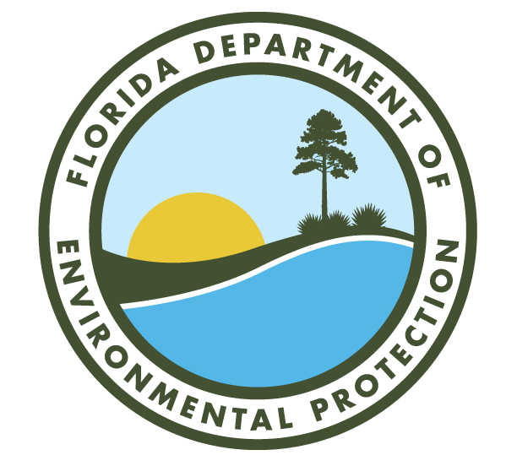
What Is a Vulnerability Assessment?
Assesses exposure and sensitivity of infrastructure, communities, and assets to flooding
Evaluates risk under 9 modeled flood scenarios
Developed in accordance with Florida Statutes Section 380.093
Funded by the Resilient Florida Program
Considers key flood risks:
  Sea Level Rise · Extreme Precipitation · Storm Surge · Groundwater Rise · Sunny Day Flooding
Notes:
The assessment includes detailed analysis of critical assets, transportation systems, neighborhoods, and disadvantaged communities.”
This project was funded through the Resilient Florida Grant Program, established by state law in 2021 and managed by the Florida Department of Environmental Protection. The program provides planning and implementation grants to help cities prepare for climate change and flooding risks.
It also allows cities like Pompano Beach to officially designate Adaptation Action Areas—places most at risk of flooding—which helps prioritize projects and unlock future funding.
Completing this Vulnerability Assessment positions the City to create an Adaptation Action Plan and apply for larger implementation grants.
The program is highly competitive—Fort Lauderdale received $25 million, and Broward County was awarded over $100 million in recent cycles. Pompano Beach is now on track to compete for that same level of investment

Slide 5
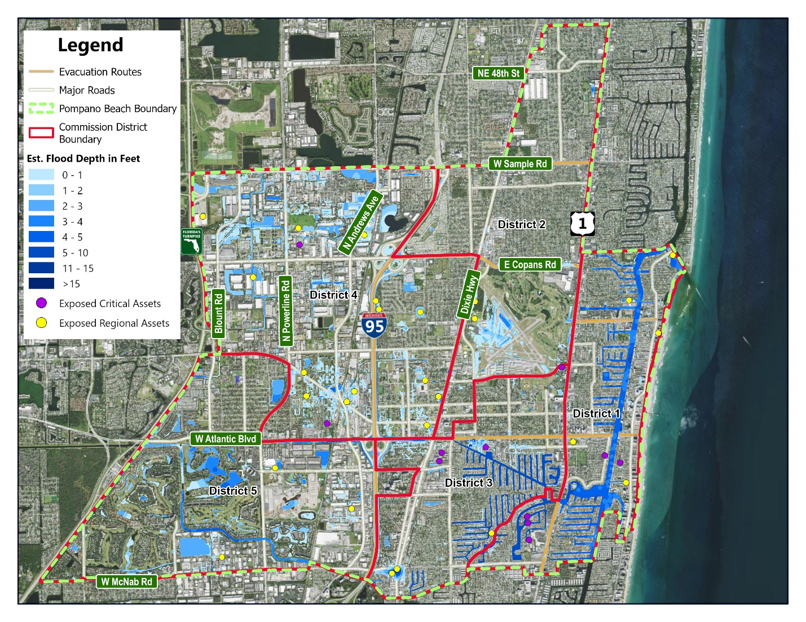
Flood Scenarios:
From Low to High Impact
Flood Scenario 1
Range of Scenarios modeled
  5-year, 100-year, 500-year, combined with compound flooding from SLR & storm surge
Worst scenarios
  Scenario 7: 100-year + storm surge)
  Scenario 9: 500-year + storm surge)
Notes:
The consultant developed nine different flood scenarios to understand how sea level rise, extreme rainfall, and storm surge could impact the City individually and in combination. The figure shown here represents Scenario 1, which models a 5-year heavy rainfall event. The good news is that Scenarios 1–4 and 6 showed limited flooding, mostly along canals and waterways. To build these scenarios, we updated the City’s Stormwater Model to reflect future conditions in 2040 and 2070, using NOAA’s 2017 sea level rise projections. We created GIS flood maps for different combinations: just rainfall, rainfall plus sea level rise, and rainfall combined with storm surge. From these, we calculated how exposed different areas are, how sensitive key assets are to damage, and overall vulnerability scores. Notably, as the scenarios become more extreme, transportation systems—including roads and evacuation routes—become heavily impacted

Slide 6
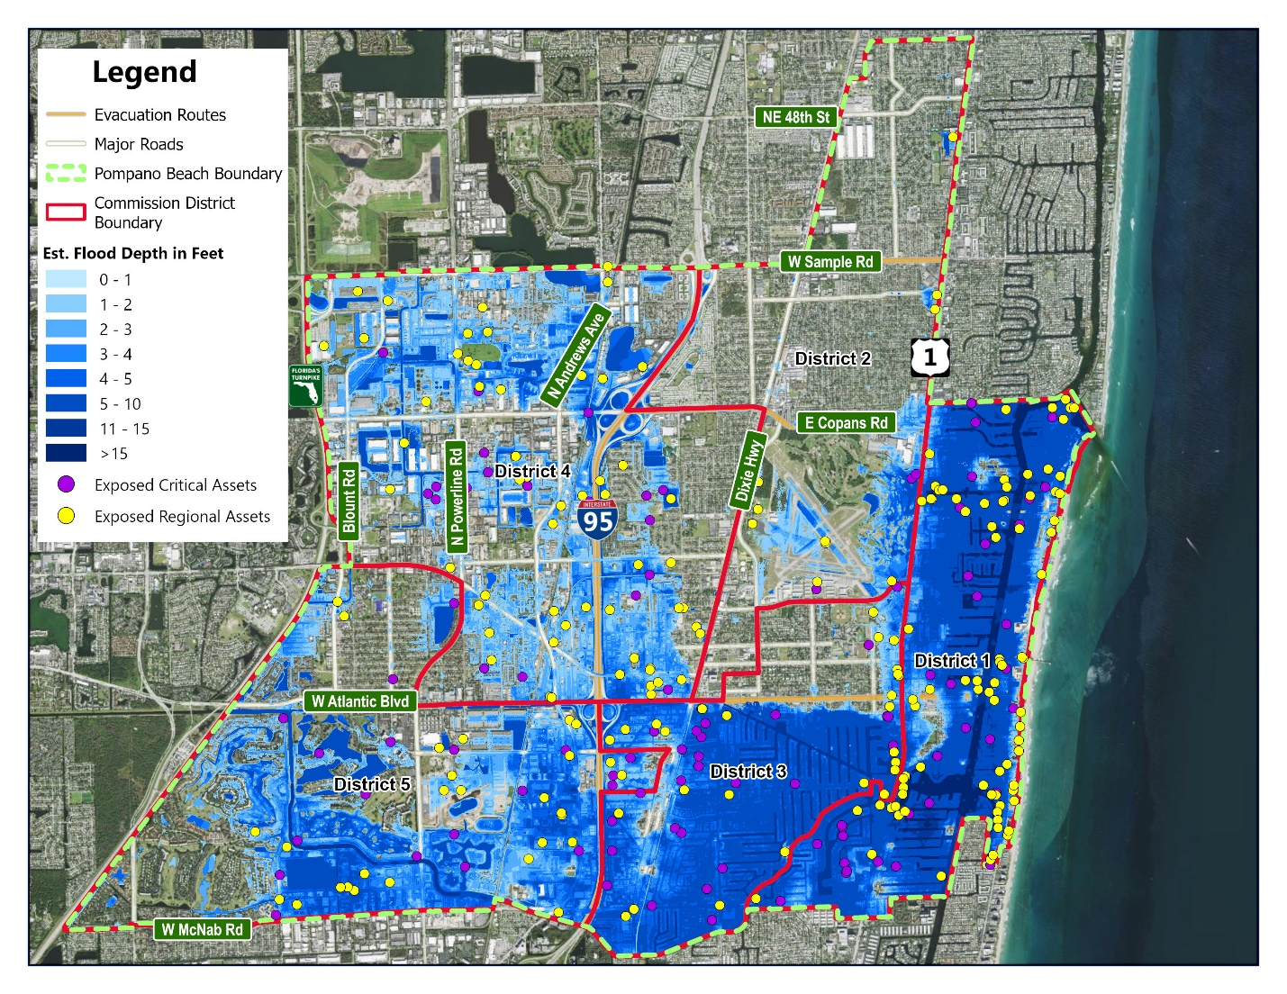
Scenario 7
Catastrophic Flood Impacts
Scenario 7: 100-year (1%) rainfall event plus storm surge
Critical Asset Type | Critical Assets Affected
Wastewater Treatment /Lift Stations | 65
Health Care Facilities | 13
Schools | 12
Fire Stations | 4
Bridges | 2
Communications Facilities | 2
Local Government Facilities | 1
Pompano High Hurricane Shelter | 1
Rail Facilities | 3
Law Enforcement Facilities | 1
Airports | 1
Total | 105
Notes:
Scenario 7 models a rare but catastrophic event—a 100-year, 72-hour rainfall combined with a 1% annual chance storm surge, like a direct hit from a major hurricane.
This scenario would cause widespread flooding across the City and impact 105 critical assets, including emergency services, utilities, and healthcare facilities

Slide 7
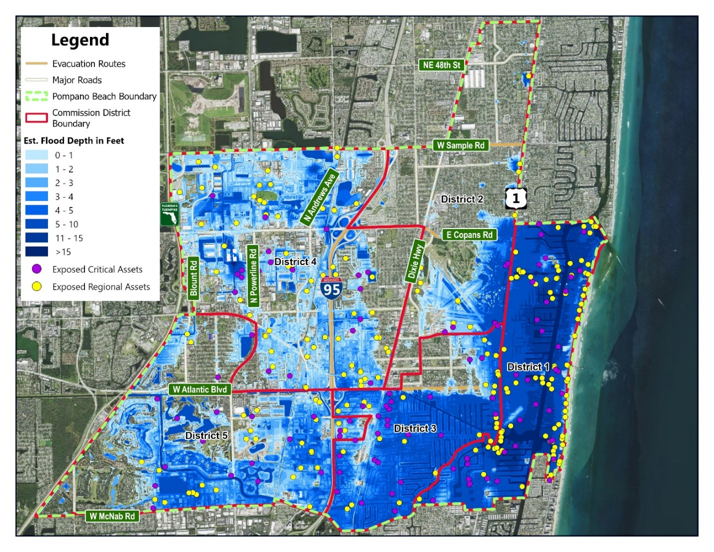
Scenario 9
Catastrophic Flood Impacts
Scenario 9: 500-year (0.2%) rainfall event plus storm surge
Critical Asset Type | Critical Assets Affected
Wastewater Treatment /Lift Stations | 67
Health Care Facilities | 14
Schools | 13
Fire Stations | 4
Bridges | 2
Communications Facilities | 2
Local Government Facilities | 1
Pompano High Hurricane Shelter | 1
Rail Facilities | 3
Law Enforcement Facilities | 1
Airports | 1
Total | 109
Notes:
Scenario 9 represents an extremely rare but catastrophic event—a 500-year, 72-hour rainfall combined with a 500-year storm surge, similar to a direct hit from a major hurricane.
This worst-case scenario would flood most of the City and impact 109 critical assets, posing serious risks to emergency response, infrastructure, and vulnerable populations.
Under this worst-case scenario, a significant amount of land area would be impacted by flooding.

Slide 8
Map Demo
Let’s Explore the Tool!
Visualizes flood scenarios citywide
  View flood risk by property address
  Filter by scenario
Assesses risk to infrastructure and neighborhoods
Supports decision-making for capital planning, emergency response, and grants
https://www.pompanobeachfl.gov/floodmap
Notes:
As part of this project, we developed an online map tool that is hosted on the City’s GIS account.
City staff will continue to have access to the tool, which can be used to analyze potential flood risk in support of planning or regulatory decisions

Slide 9
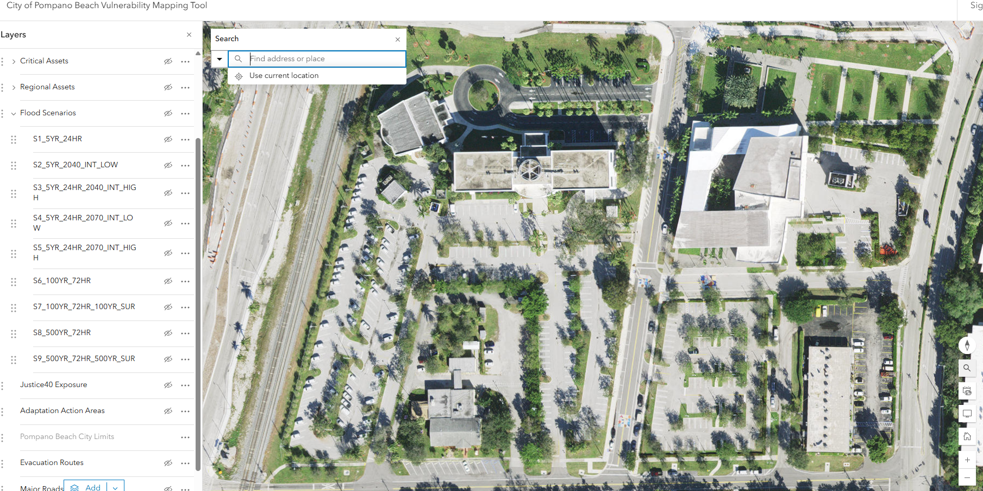

Slide 10
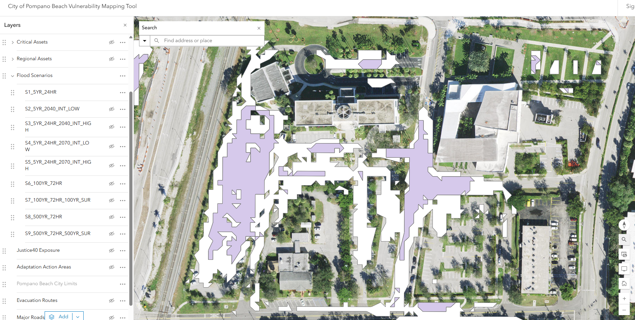

Slide 11
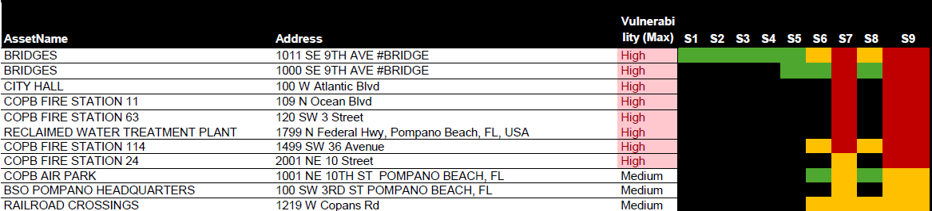
Recommendations
Developed a Priority list of Critical assets
Evaluate, plan, and coordinate
The recommended AAA boundary is the entire City (same as City boundary)
Notes:
We identified City-owned and regional assets most vulnerable to flooding. Key facilities include City Hall, fire stations, reclaimed water plants, SE 9th Ave bridge, the airport, and BSO HQ.
Schools, healthcare centers, and disadvantaged communities also face high risk—some with 60–99% exposure in major scenarios.
We recommend evaluating access to flood-prone fire stations, assessing risks to elder care facilities, and upgrading vulnerable lift stations.
We also propose designating the entire City as an Adaptation Action Area. This allows flexibility and strengthens future grant applications.
Next steps include evaluating protective measures, developing a formal Adaptation Plan, and coordinating with partners like schools and healthcare providers

Slide 12
Next Steps:
Moving From Assessment to Action
Final Vulnerability Assessment
Adaptation Action Plan
Implement Adaptation Projects
Notes:
The City has received funding through the Resilient Florida Program to create an Adaptation Action Plan.
The plan will prioritize projects that address the flood risks identified in this study, with cost-benefit analysis, funding strategies, and an implementation roadmap.
We also recommend further evaluating vulnerable critical assets to identify specific protection needs.

Slide 13
Questions?
Contact Us:
Christina Viala
Email: christina.viala@copbfl.com
Phone: 954-786-5541
Notes:
The full VA report includes detailed findings, methodology, and the updated stormwater model.
We’ve also provided GIS data and documentation for the online map tool.
Happy to answer any questions

