Slide 1
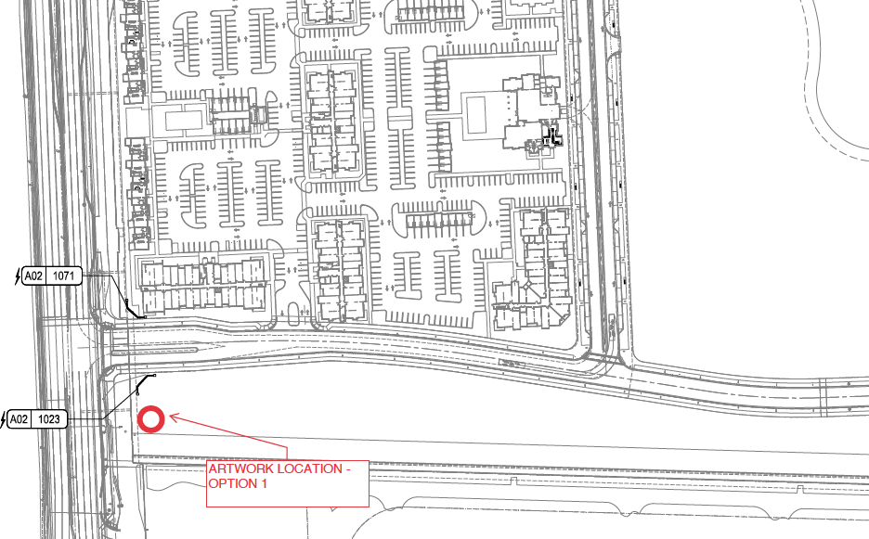
Pompano Live! will supply pad and lighting.
Powerline Rd.
Location
N. Cypress Bend

Slide 2
